Slide 1



USING HOME FOR SINGLE FAMILY HOME OWNERSHIP
Kevin Howard | Director
Email khoward@LittleRock.gov​
​

Slide 2
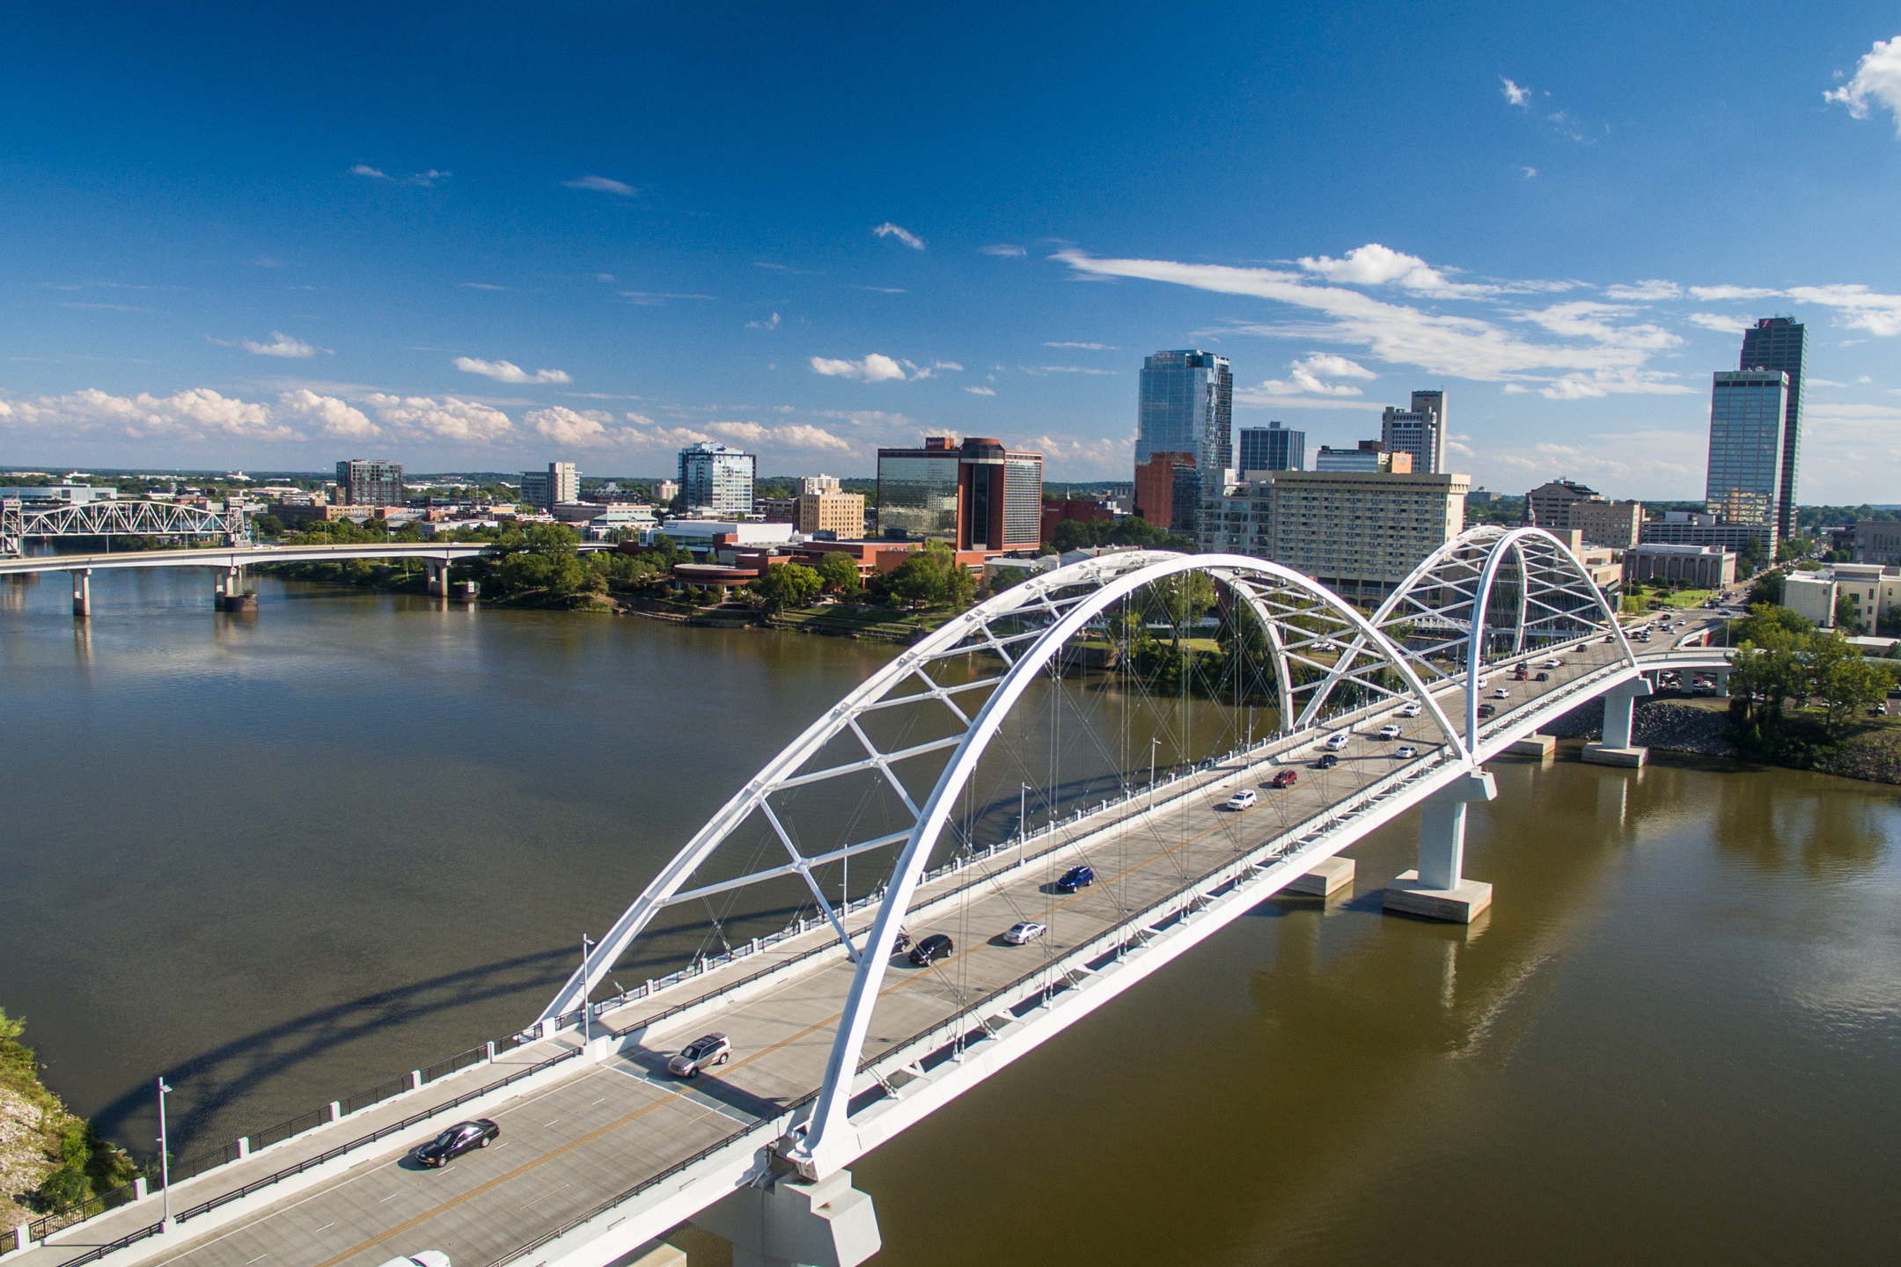


City of Little Rock Demographics
  Population: 205,314
  Size: 125 square miles
  Median Household Income: $58,697
  Median Value of Housing units: $205,800

Slide 3

Community development team
2025 Income Limits-Central AR (Little Rock, NLR, Conway)
80% of Area Median Income
Household Size | Maximum Income Limit
1 | $51,950
2 | $59,350
3 | $66,750
4 | $74,150
5 | $80,100
6 | $86,050
7 | $91,950
8 | $97,900

Slide 4


The City of Little Rock Homeownership Programs – Using HOME Funds
1. Little Rock Home Buyers Program – New Constructions/Acquisition Rehab
2. Down Payment Assistance Program
3. Work with Your CHDO’s (Community Housing Development Organizations)
4. Private Public Partnerships – Develop Land Bank Property
5. Create a Land Bank or Community Land Trust.
6. Unsafe and Vacant Structures – Work with Developers or owners of the properties to rehab or renovate those units to provide Affordable Housing.

Slide 5
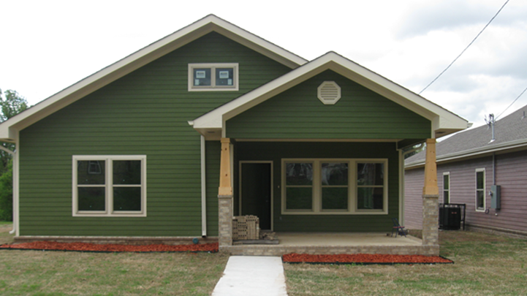
New Construction

Slide 6
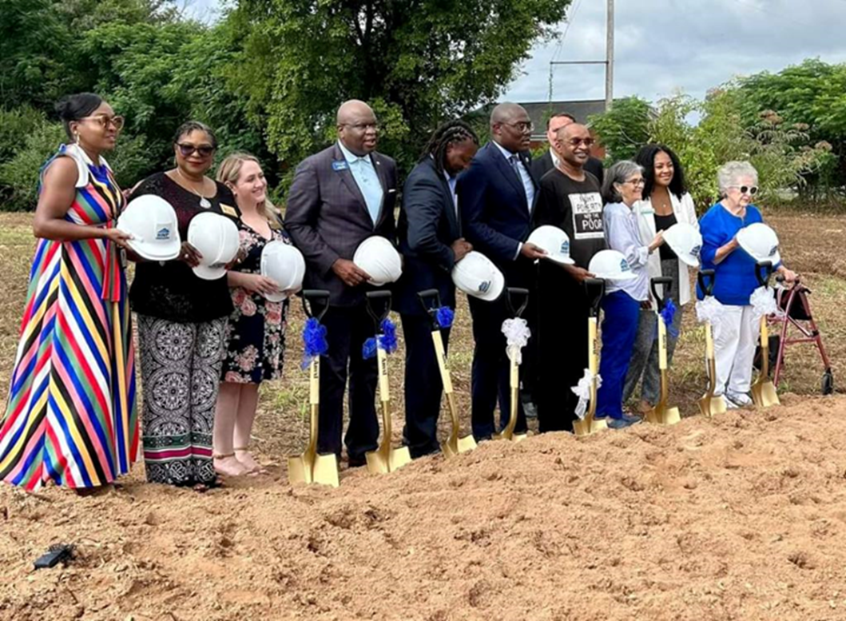
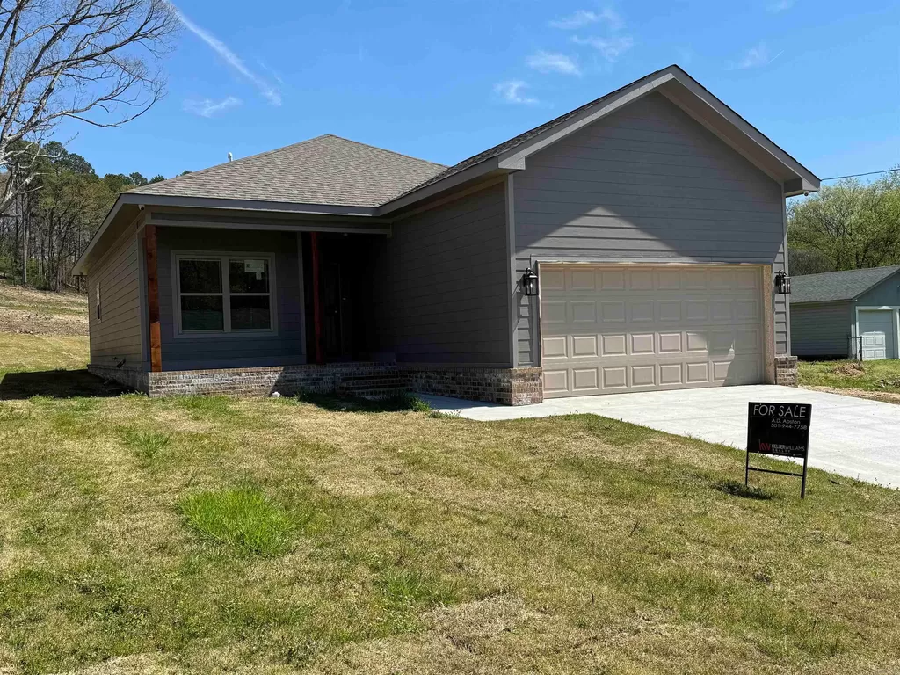
NEW CONSTRUCTION
Up to $20,000 in subsidies
Develops in house and partners with CHDOS
Bided out through Invitation to Bid
Environmental Review completed prior to spending
City allocates $740k of HOME 2024 budget ($200K from PI)
4403 Bowers- 3 bed/2 bath 1,243 sqft. $199,000

Slide 7
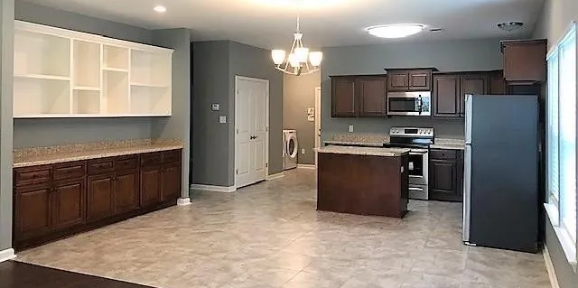

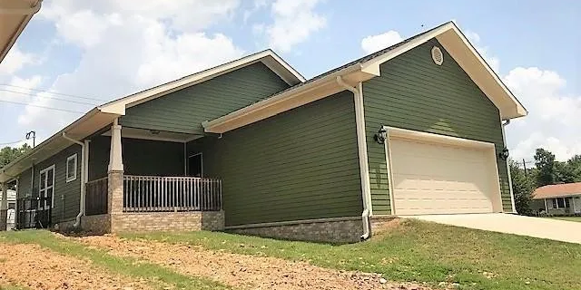
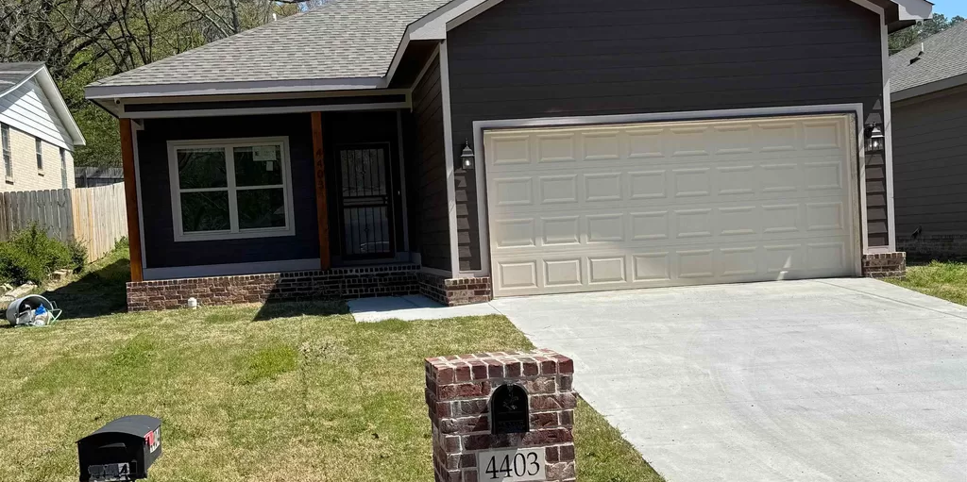
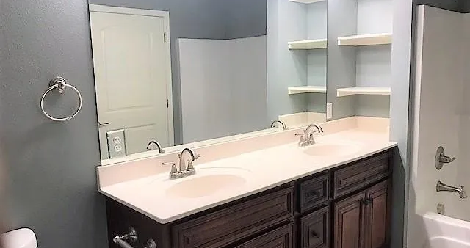

New Construction
Developers Must
Have Bid Bond
State Contractors License
Not be disbarred (SAM.GOV)
1 Year general warranty
5 Year roofing warranty
Return proceeds to City as Program Income

Slide 8
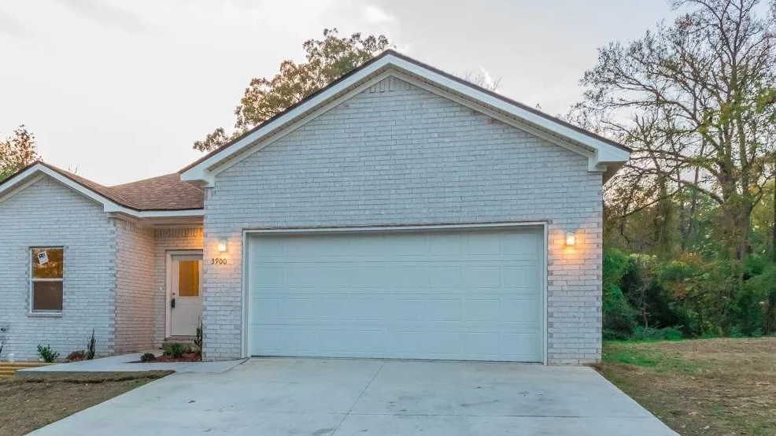
CHDO’S
Community Housing Development Organizations

Slide 9
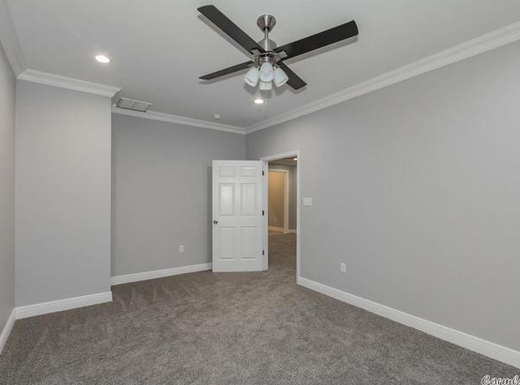
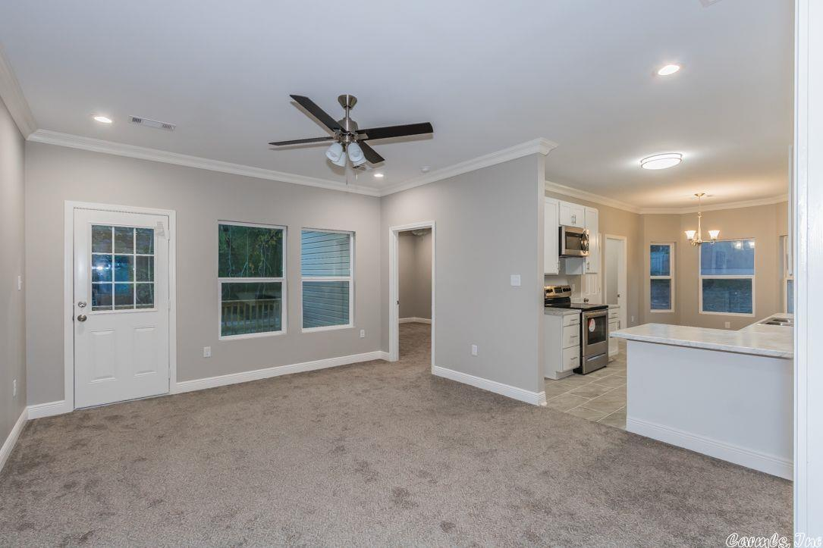

City of Little Rock
Certified CHDO’S
Better Community Development (BCD)
University District Development Corporation (UDDC)

Slide 10
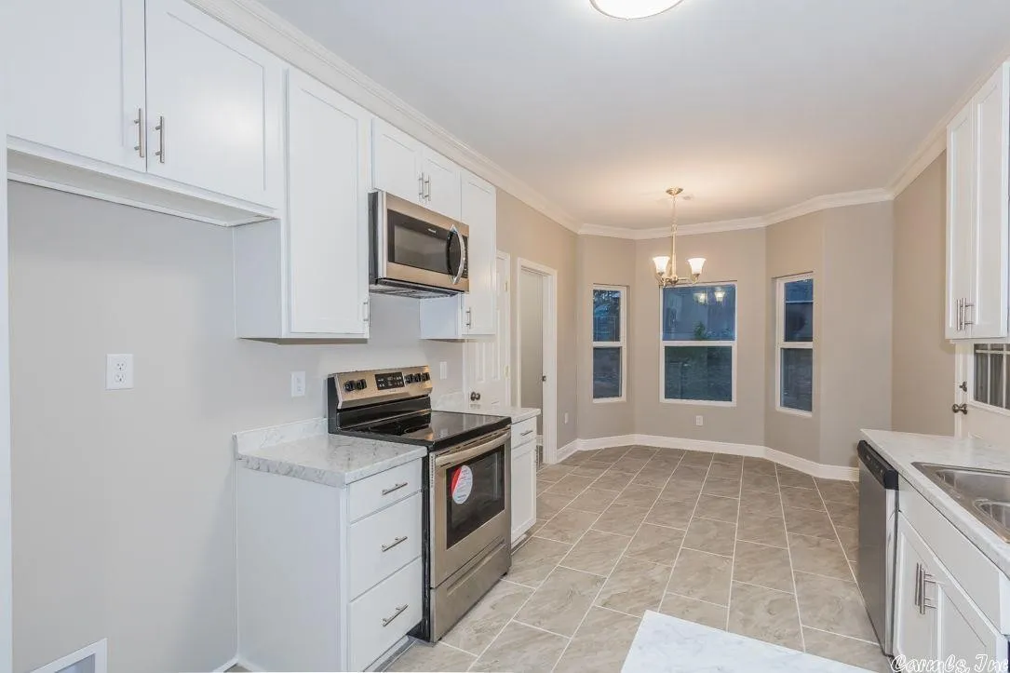
City of Little Rock
CHDO Requirements
Respond to Request for Proposals (RFP)
Have Bid Bond
State Contractors License
Not be disbarred (SAM.GOV)
1 Year general warranty
5 Year roofing warranty
Written Agreement
Developers fee not to exceed 7.5-10% of project costs
100% of funds expended within 1 year
Sell home within 6 months of completion
Return proceeds to City as Program Income

Slide 11
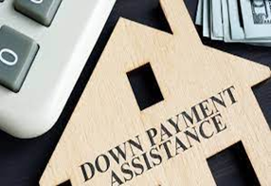
Down Payment Assistance (DPA)

Slide 12
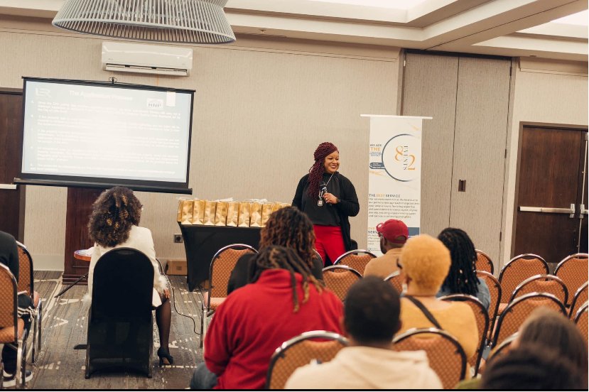
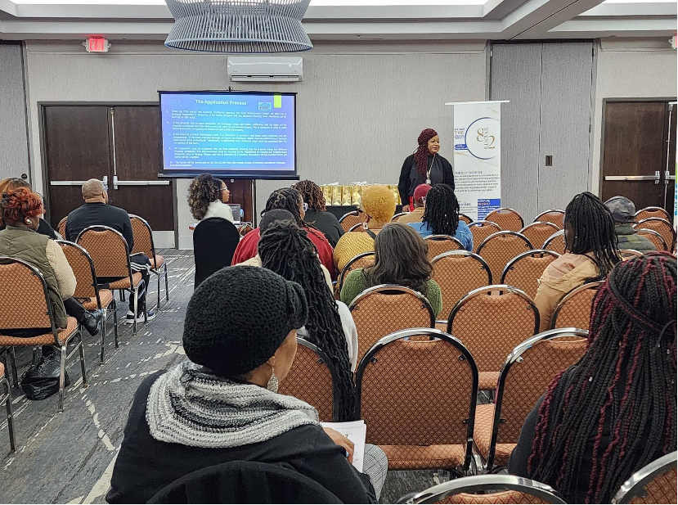
Down Payment Assistance (DPA)
Up to $10,000 in closing costs
Must meet income guidelines
Buyer must be first-time homebuyer
Buyer must own/occupy for 5 years
Home must pass inspection- Brought up to all local code standards
City allocates $200k of HOME budget
Average 20 subsides per year
City holds Annual DPA Workshop – First Time Homebuyers Lenders, Banker, Relators

Slide 13
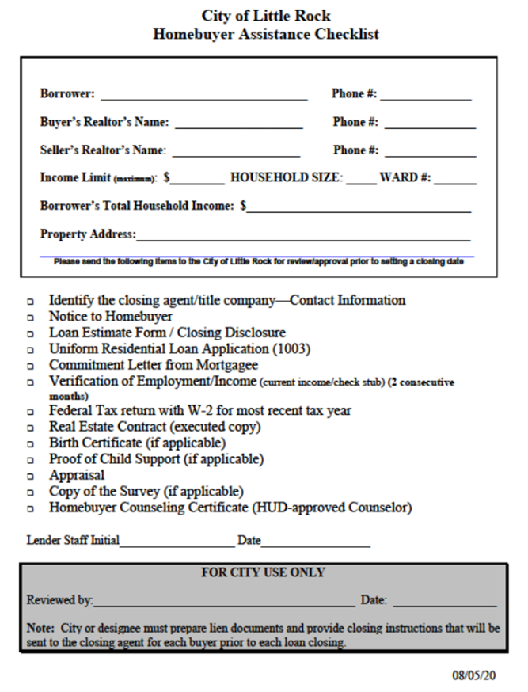

Down Payment Assistance – Checklist
Provide the closing agent/title company – Contact Information (Phone#)
Notice to Homebuyer
Loan Estimate Form/Closing Disclosure
Uniform Residential Loan Application (1003)
Commitment Letter from Mortgagee
Verification of Employment/Income(current income/check stub) 2 consecutive months
Federal Tax returns with W-2’s for last two years (if applicable)
Real Estate Contract (executed copy)
Birth Certificate (if applicable)
Proof of Child support (if applicable)
Appraisal
Homebuyer Counseling Certificate -HUD-approved
City holds Annual DPA Workshop – First Time Homebuyers Lenders, Banker, Relators

Slide 14

Public Private Partnerships

Slide 15
Create a Land Bank Commission
Community development team
City of Little Rock Land Bank Mission:
Reverse blight
Increase Homeownership
Stability of property values
Provide affordable housing
Improve the health and safety of neighborhoods within the City of Little Rock
Maintain the architectural fabric of the community
The Land Bank Commission provides properties through the acquisition, and disposition of vacant, abandoned, tax delinquent, and city lien property. In collaboration with residents, neighborhoods, developers, nonprofit organizations and other governmental agencies to develop affordable housing and increase homeownership.

Slide 16
Community development team
Questions?

Slide 17

Community development team
Thank you
Kevin Howard| Director
@citylittlerock

